Slide 1
SFIA 2 Project
Adelina Bronda

Slide 2
The Brief
A Kanban board;
Application to be fully integrated using the Feature-Branch model;
Project must follow Micro Services architecture;
Project must be deployed using containerisation and an orchestration tool;
Must create an Ansible Playbook to provision the environment that the application needs to run.

Slide 3
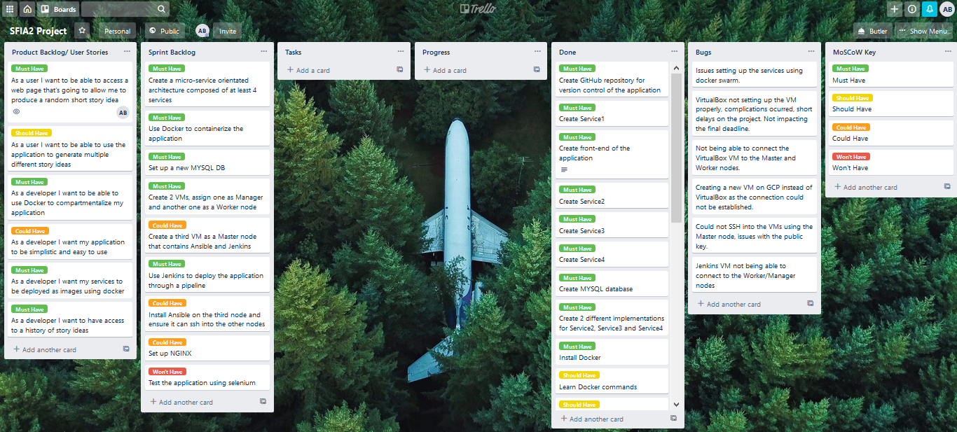
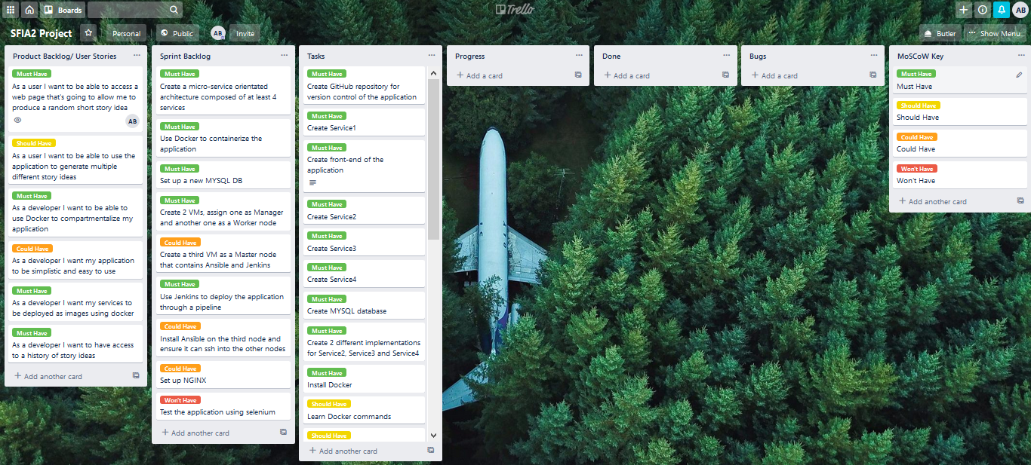
My Solution

Slide 4
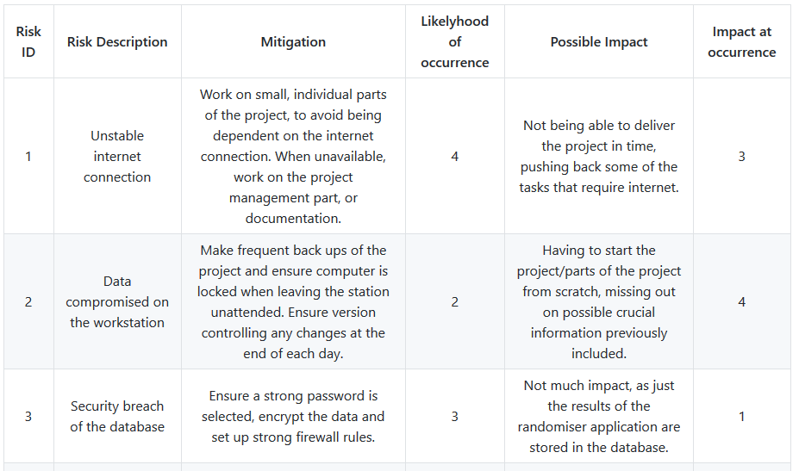
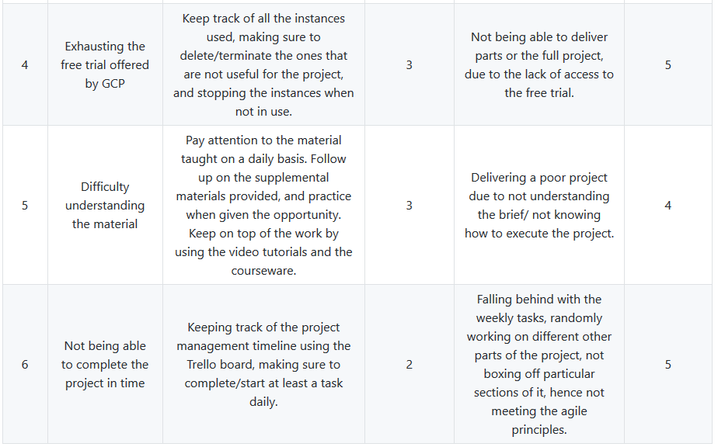
My Solution – Initial Risk Assessment

Slide 5
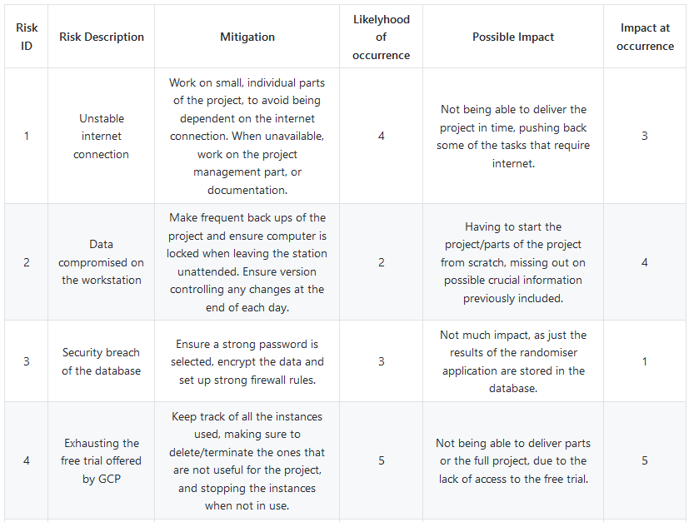
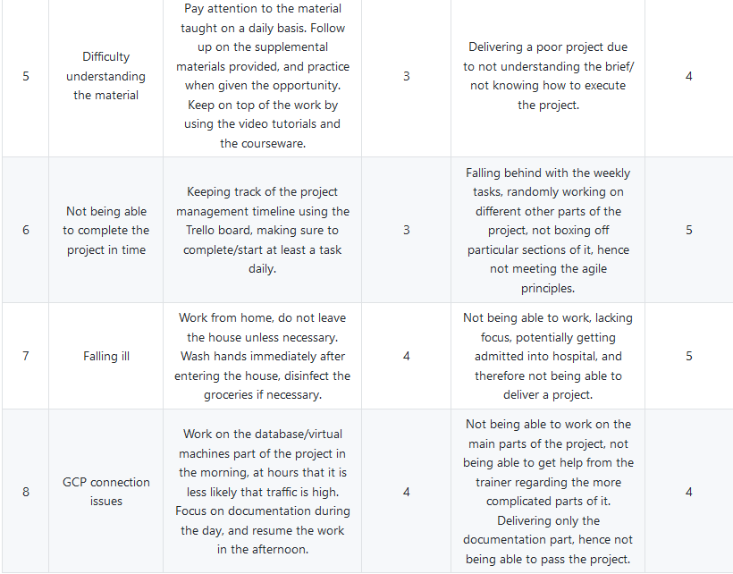
My Solution – Final Risk Assessment

Slide 6
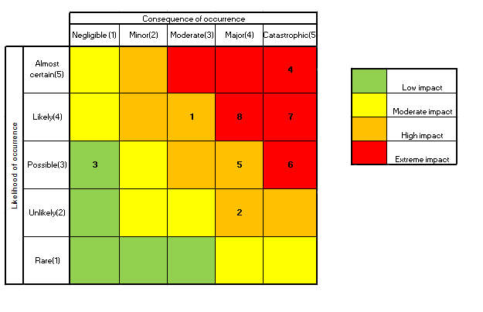
My Solution – Final Risk Assessment

Slide 7
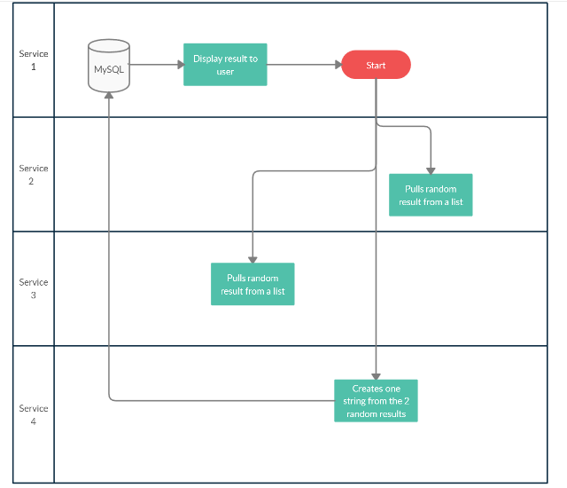
My Solution – Service Architecture Diagram

Slide 8
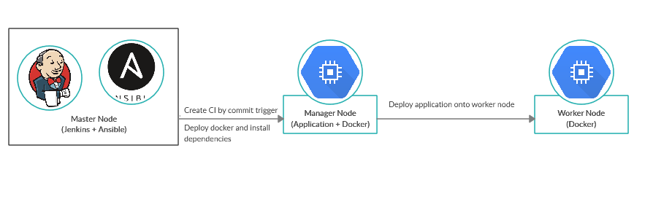
Deployment

Slide 9
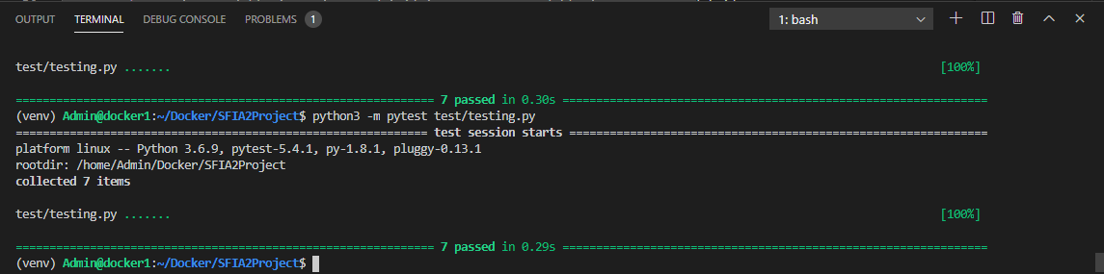
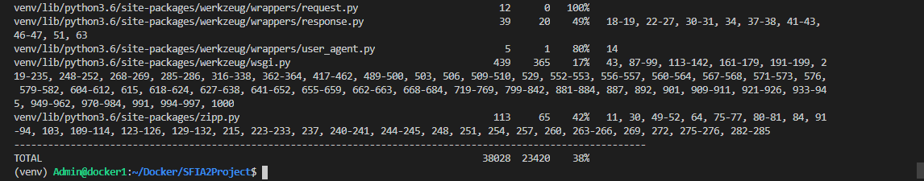
Unit Testing

Slide 10
Retrospective – What Went Well
Project completed in time
Implemented Jenkins
Deployed Docker Swarm with little to no issues
Deployed the application on 3 different VMs

Slide 11
Retrospective – What Went Wrong
Issues when trying to ssh into the other VMs using Jenkins
Deleting and re-creating the entire project just before the deadline
Issues setting the manager node on VirtualBox, hence having to resort to using another VM on GCP

Slide 12
Retrospective – Future Improvements
Further development of the front end of the application
Integrating testing scripts within Jenkins
More test cases to implement, hence improving coverage
NGINX implementation
CRUD implementation
Selenium testing

Slide 13
Demonstration

Slide 14
Thank you for listening Any questions?

